Slide 1
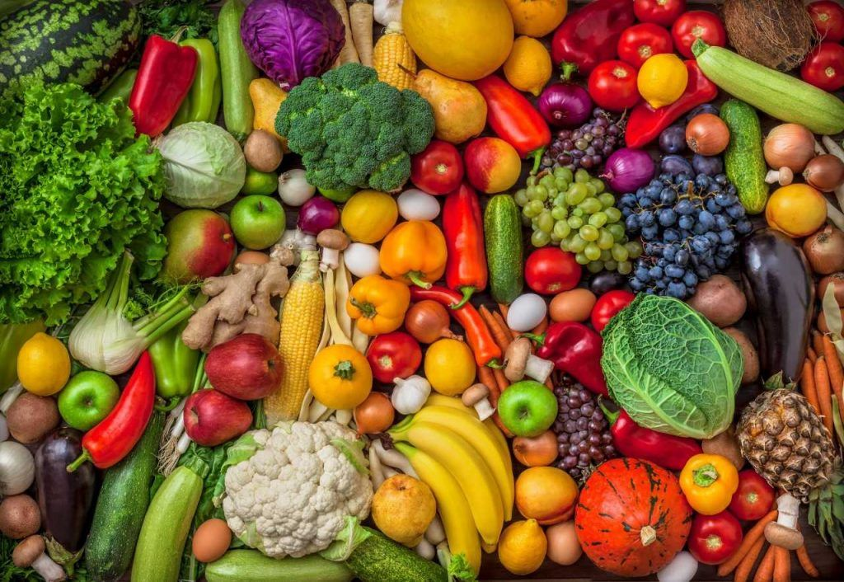
HEALTHY BODY HEALTHY MIND
BY ROLL NO. 41 TO 44

Slide 2
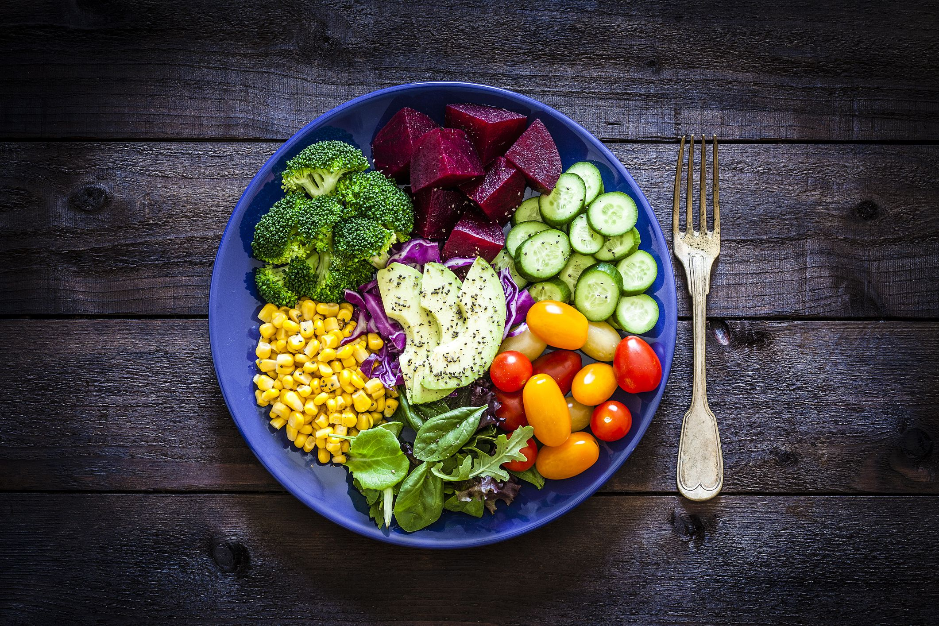
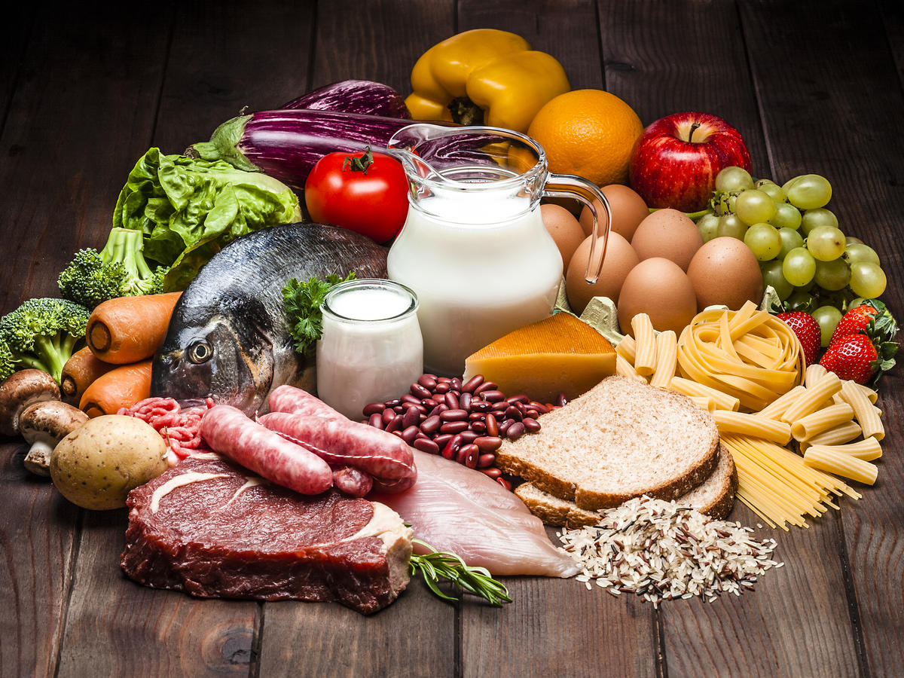
HEALTHY DIET
We should improve our diet. Try to eat more real and homemade food. Take less Sugar, Salt and outside foods. Eat more fruits and vegetables. Control oily foods. Drink more water.

Slide 3

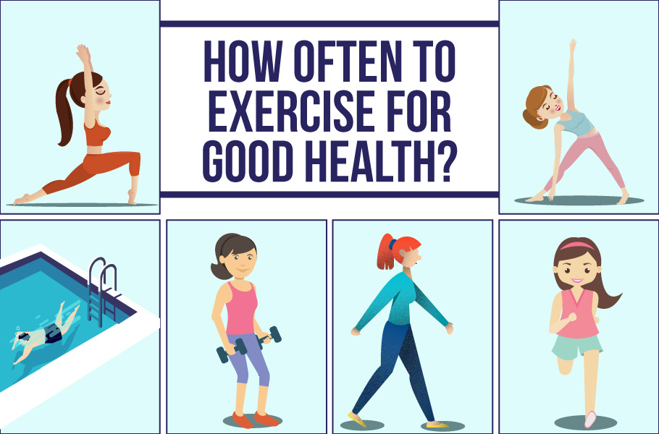
EXERCISE
Exercise is essential for healthy body. We need to do exercise at least 30 minutes a day. Walking, Swimming, Cycling and Laughing is the best exercise. Exercise can improve your health and reduce the risk of developing several diseases. It helps to reduce cholesterol level and weight. It helps to reduce the risk of Heart Attack.

